Slide 1

PROPOSAL TO DEVELOP AN INVENTORY MANAGEMENT SYSTEM.
STUDENT NAME
INSTITUTION AFFILIATION
PROFESSORS NAME
DATE

Slide 2

Agenda.
Introduction
Problem statement.
Objectives.
Background study.
Methodology
Performance analysis
Conclusion
image link: inventory management system images

Slide 3
Introduction.
An inventory management is the process by which an individual or an organization tracks goods and services throughout the supply chain of an organization.
It governs how you approach inventory management for your business

Slide 4
Problem Statement
The inability to effectively and efficiently manage the technical and the organizational processes led to the development of the new inventory control system.
These problems involved :
supply outages in high seasons,
frequent delays and
increased complaints from customers.

Slide 5
Objectives.
Main objective: The main aim of this proposal is to develop an inventory management system that increase productivity and profitability.
Specific objectives:
To design a platform where organizations can share and distribute
To manage inventory reports.
To facilitate proper planning and forecasting.

Slide 6
Background study.
Results of an extensive computational study show that, given the effectiveness associated with both directing capacity and holding inventory, manufacturers should consider the workforce's capacity to learn when making job assignments during production ramp up.
Analysis of the results suggests that inventory and capacity building patterns depend on product value and the workforce's experience levels. Further analysis shows that slower learners and those with the potential to achieve higher productivity should specialize more (valeva et al, 2019).

Slide 7
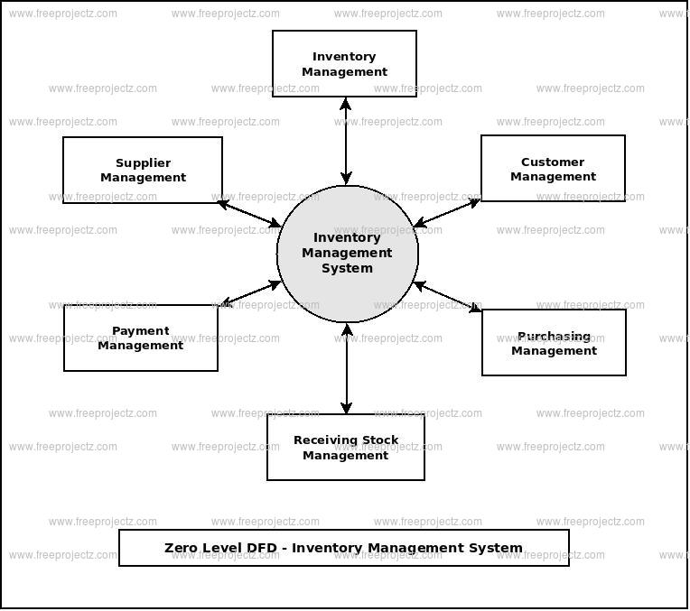

Background study cont… animation url: https://www.youtube.com/watch?v=VHrEX9WI4L0 image link: inventory management system images

Slide 8
Methodology: Iterative and incremental method.
Iterative and incremental method which starts with the initial planning and ends with deployment with the cyclic interaction in between.
Basically, the idea here was to develop a system through repeated cycles and in smaller a time.
Doing it this way allowed me to develop a system based on the experience learned in earlier parts of the system. It consists of mini waterfall.
More on iterative and incremental method: https://www.youtube.com/watch?v=FTygpfEFFKw

Slide 9

Performance analysis.
the organization will use the high-quality RFPs in equal to high quality responses. This involves determining the different responses of the bidders to determine which one amongst them will provide the best proposal.
Using a previously defined system for scoring, each item within the inventory management system can be ranked based on the degree to which it aims at fulfilling the goals of the inventory control system.
Animation url: https://www.youtube.com/watch?v=w4ralwhJR9E

Slide 10
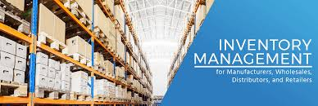
Conclusion. image link: inventory management system images
it is important for the company to monitor and control the flow of inventory and distribution of end-products to the markets.
the company needs to offer exceptional methods for implementation of the proposal for the development of the inventory control system

Slide 11
Reference.
Atieh, A. M., Kaylani, H., Al-abdallat, Y., Qaderi, A., Ghoul, L., Jaradat, L., & Hdairis, I. (2016). Performance improvement of inventory management system processes by an automated warehouse management system. Procedia Cirp, 41, 568-572.
Jain, S. (2015). Types of Contracts: General and Specific Contracts. Available at SSRN 2781255.
Star, S., Russ-Eft, D., Braverman, M. T., & Levine, R. (2016). Performance measurement and performance indicators: A literature review and a proposed model for practical adoption. Human Resource Development Review, 15(2), 151-181.
Valeva, S., Hewitt, M., & Thomas, B. W. (2020). Managing uncertainty in demand through inventory and workforce development. International Journal of Production Research, 1-21.

